Slide 1


Advisor : Hoon Sung Chwa
Weekly Meeting
2023.04.24
Dept of Information & Communication Engineering, DGIST
Real-Time Computing Lab
Kang Young Eun ( kye0520 @dgist.ac.kr)

Slide 2
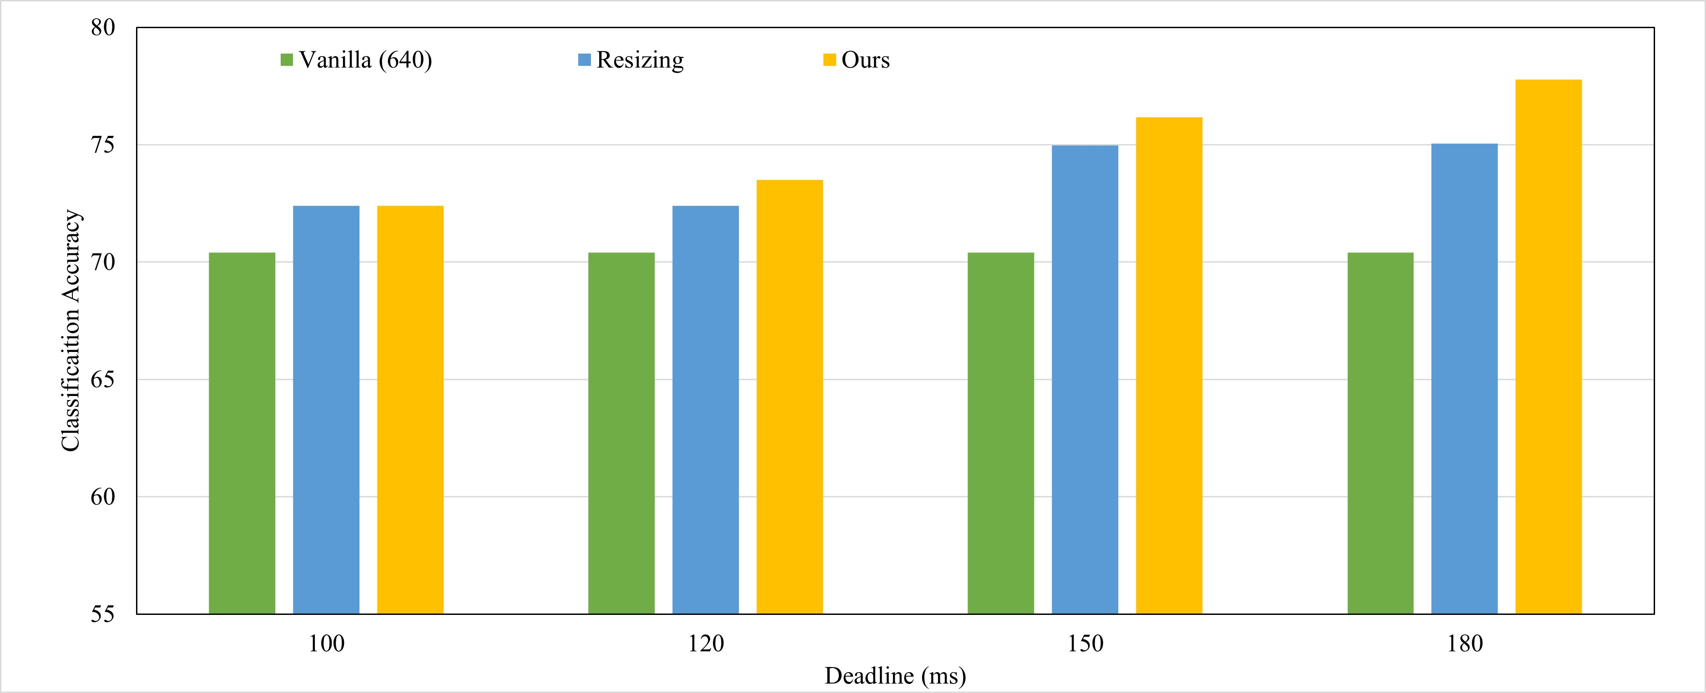
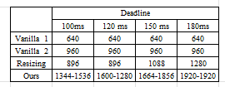
Evaluation
Average detection accuracy comparison with baselines
Corresponding Image Resolution
2
Notes:
바닐라 640과 비겨 한 결과.
vanilla object detection 을 그냥 진행하는 경우 640으로 진행되기 때문에 이로 설정.
모든 경우 vanilla가 deadline을 만족한다.
Canvas size를 점차 키워서 원본의 이미지 사이즈에 가깝게 중요한 objec를 detect할 수 있다는 점이 갈 수록 resizing과의 차이를 낸 것으로 보인다.
반면 resizing의 경우 이미지의 크기를 일정 부분 키우면 saturate된다는 점이 우리 모델과의 차이를 더 크게 만든것.

Slide 3
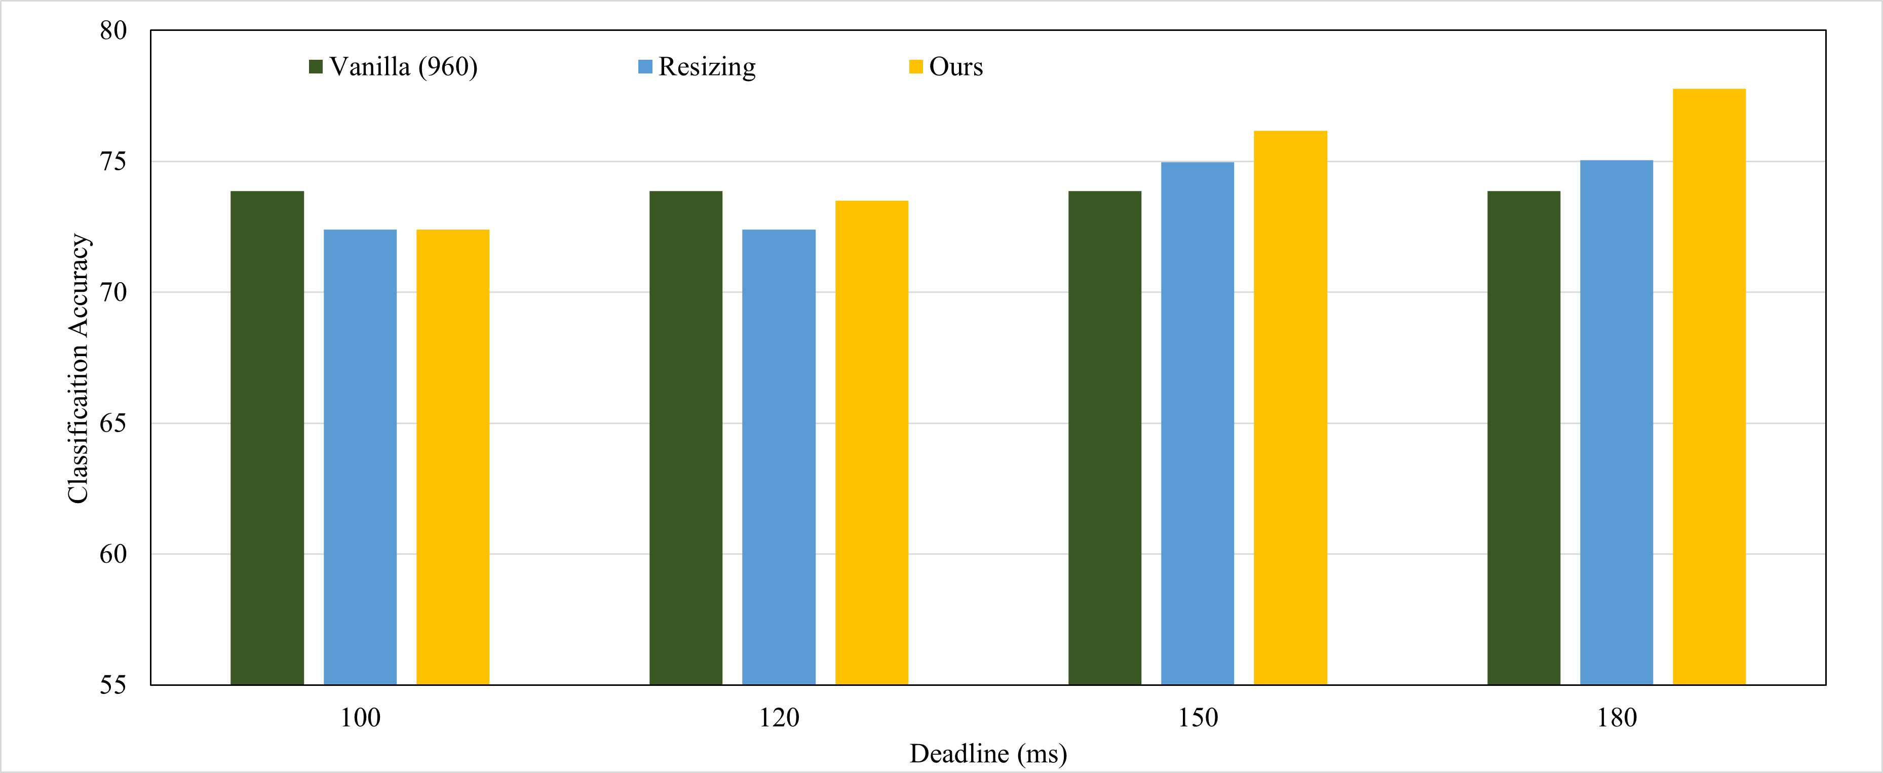
Evaluation
Average detection accuracy comparison with baselines
Corresponding Image Resolution
3
Notes:
다음으로는 960의 바닐라 이미지 사이즈와 비교한 결과이다.
deadlin이 100인 경우와 120인 경우에 resizing과 우리 모델 보다 크게 되는데 이는 deadline miss를 하는 값들이다.
또한 150, 180ms로 deadline을 만족시키는 바닐라의 경우에는 vanilla보다 더 좋은 결과를 보였다.

Slide 4
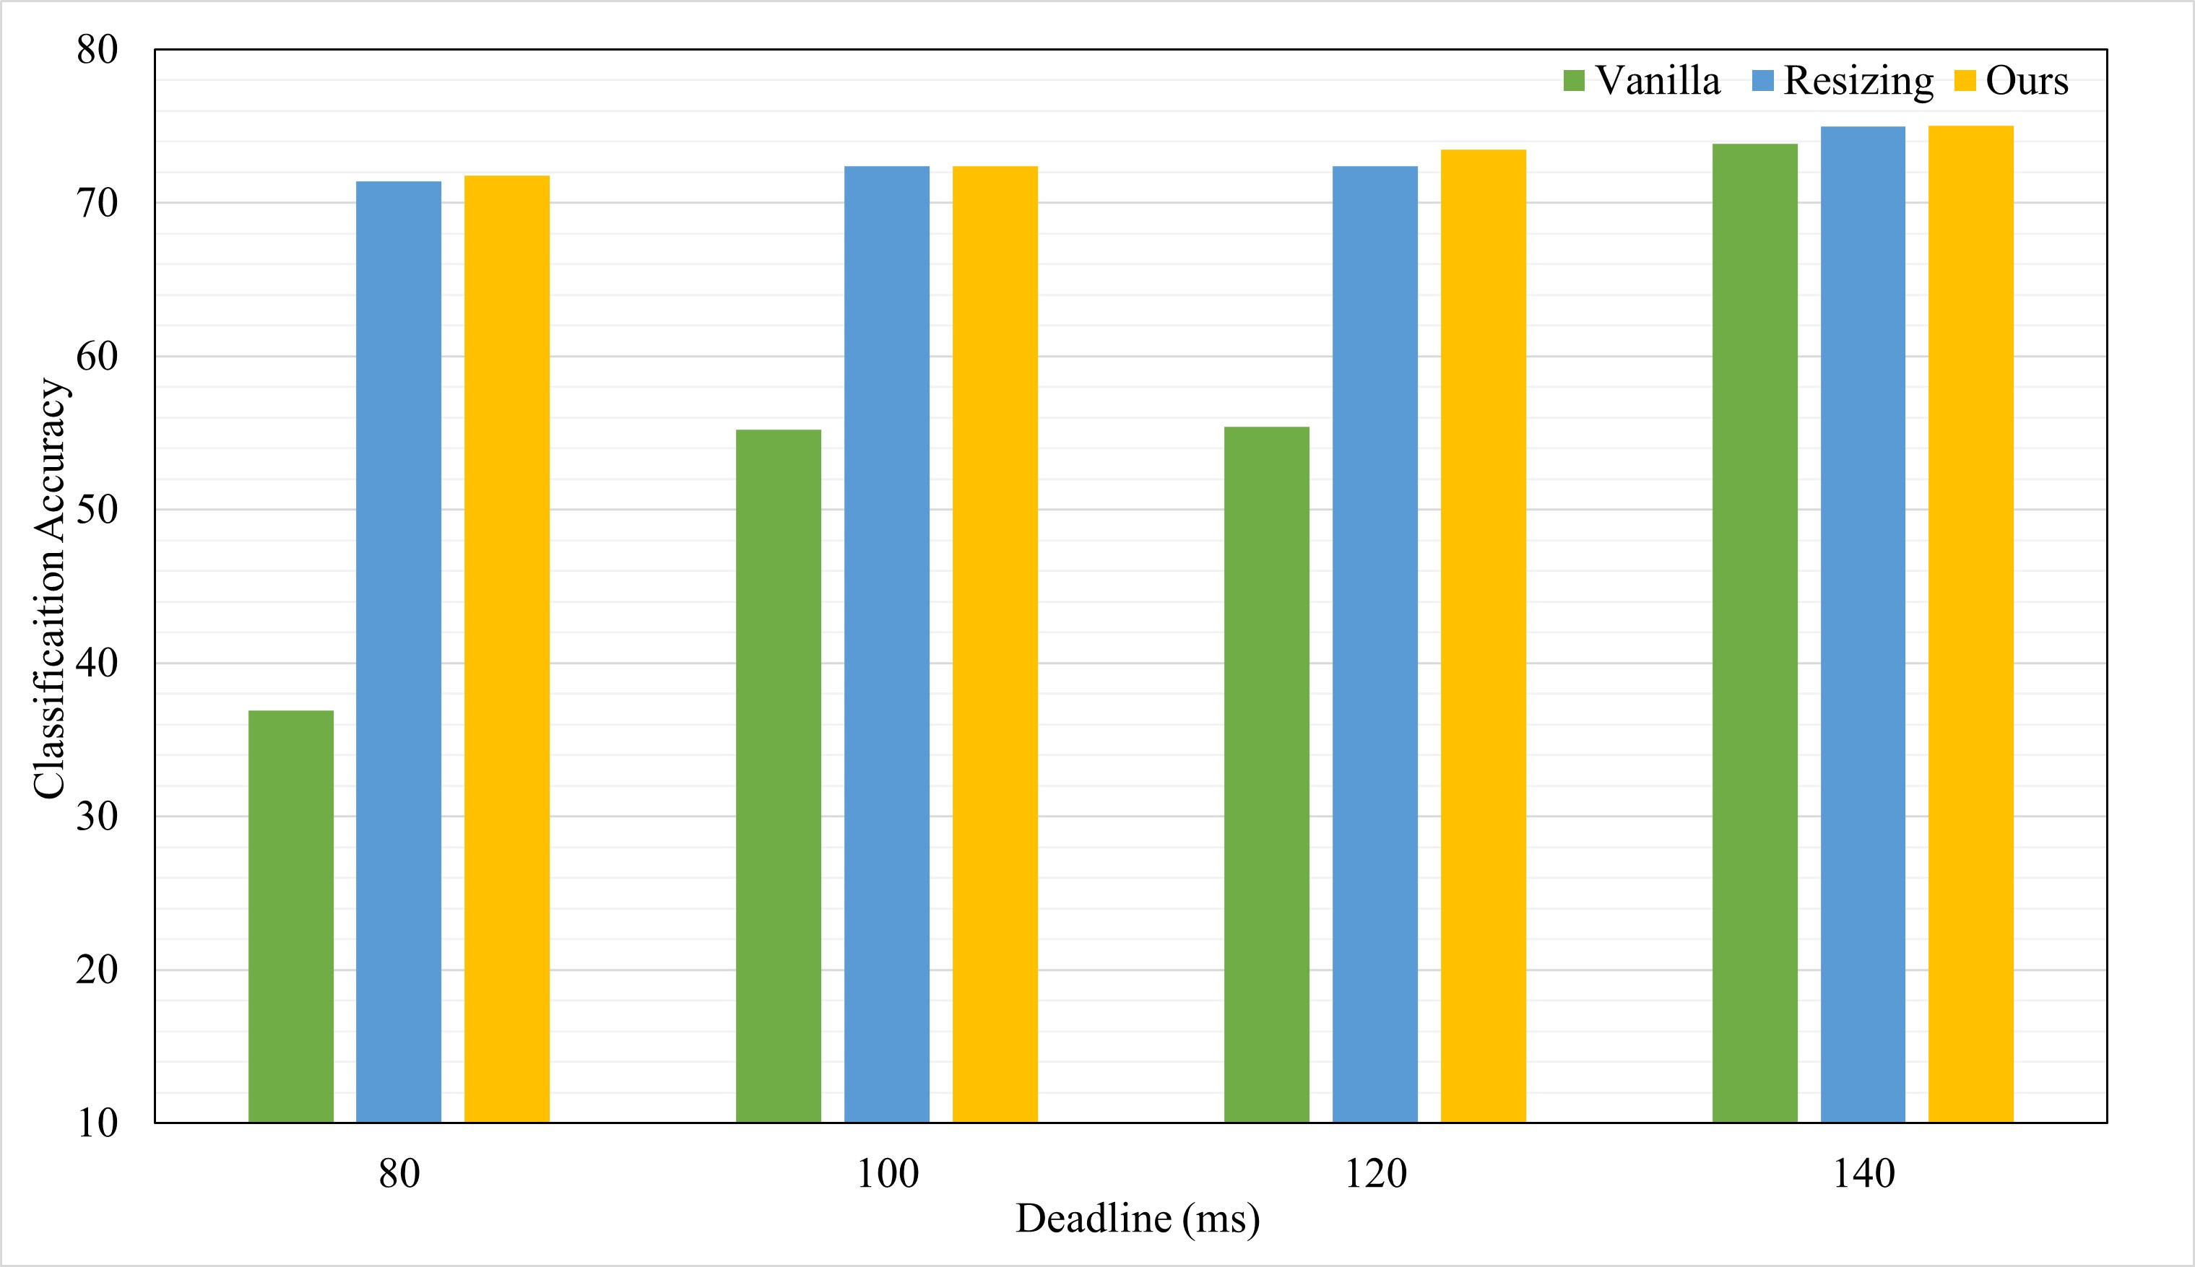
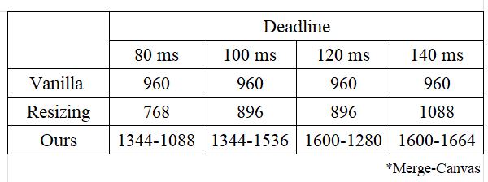
Evaluation
Classification Accuracy
Average detection accuracy comparison with baselines
Corresponding Image Resolution
Deadline Miss!
Results show our higher accuracy results without deadline miss
4

Slide 5
Evaluation
Deadline miss comparison
Deadline Miss ratio comparison
Vanilla is vulnerable to dynamically changing deadlines.
Batching also misses deadline due to static image size.
Dynamically deciding Merge and Canvas size according to deadline helps meet deadline at any dynamically changing circumstances.
5
Notes:
1344-1536(100) 1600-1280(120) 1600-1664 (140)
optimal 한 batching 값이 있는데 우리 기준이 되는 개수로는 optimal 하지 못하다는 것.

Slide 6
Model Design
Camera Image
Decision Module
RoI Detection
Image Merge
Object Detector
RoI result
Merge Size
1
2
Canvas Size
3
4
Bounding Box Mapping
Yolov5
Detection Result
Post Processing
Image Patching
Recursive Packing
RoI Size Decision
RoI Crop
Patch Module
6
Notes:
Merge
Patch

Slide 7
Evaluation
Comparison Models
Vanilla : YOLOv5
Resizing vanilla
Batching
Merge+Patch Model (Ours)
Merge+Patch Model without density (scaling only)
Merge+Patch Model without object scaling (density only)
7
Notes:
deadline miss ratio
Classification accuracy
Breakdown latency of patching framework

Slide 8
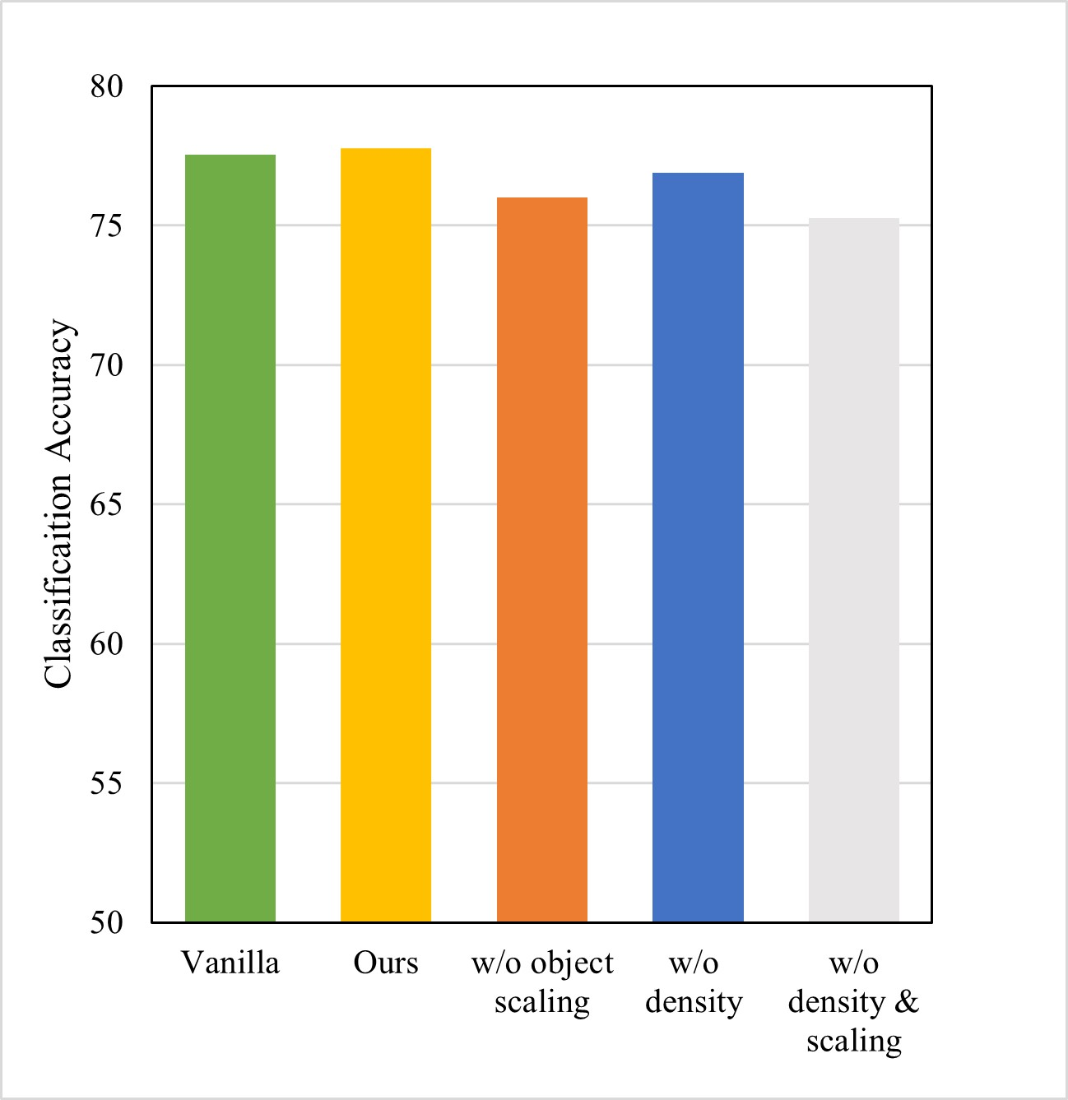
Evaluation
Classification Accuracy 2
Average detection accuracy comparison with and without object scaling and density
T
Therefore, object scaling and density consideration is essential approach to higher classification accuracy.
8
Notes:
Fps requirement/ deadline을 결정할

Slide 9
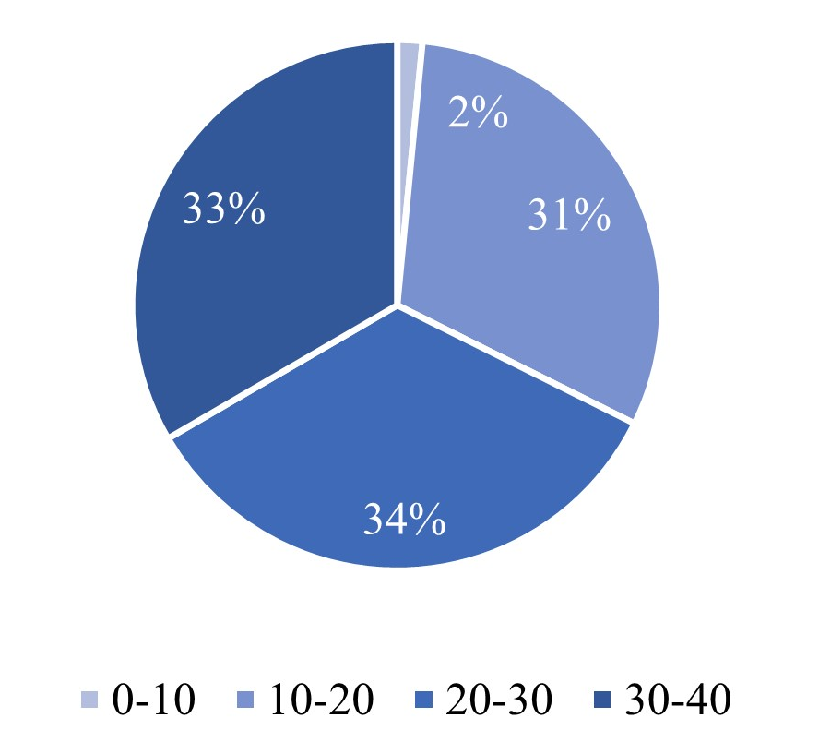
Evaluation
Classification Accuracy 3 : Density
Number of object distribution per frame
Accuracy of different density
Density Level
H : Frame of previous object number over 25.
L : Frame of previous object number under 25.
9
Notes:
Fps requirement/ deadline을 결정할

Slide 10
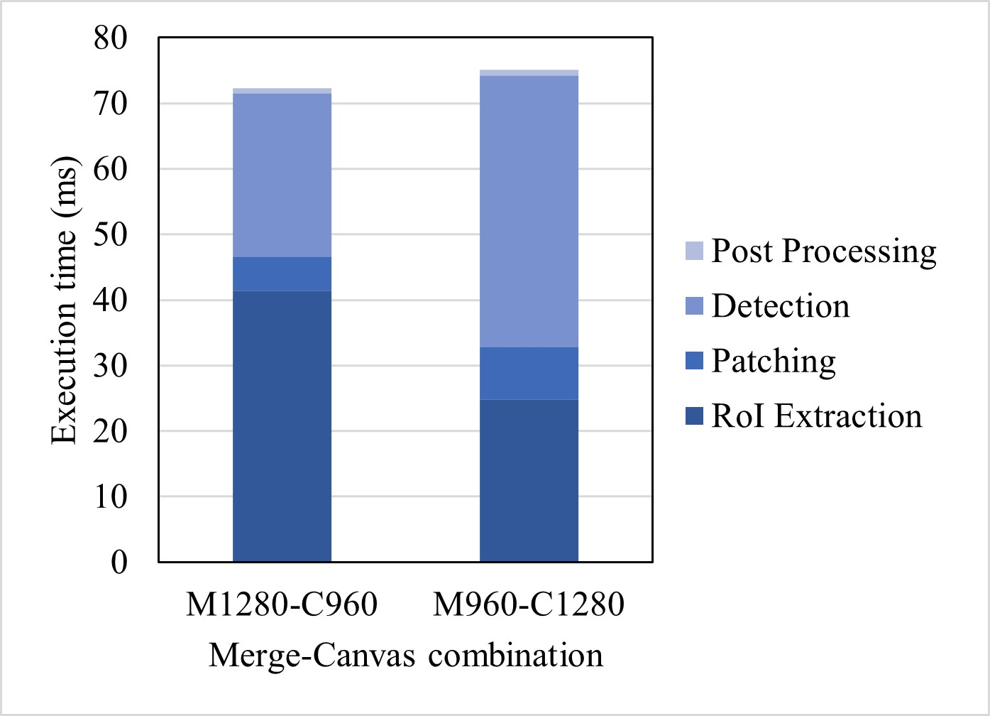
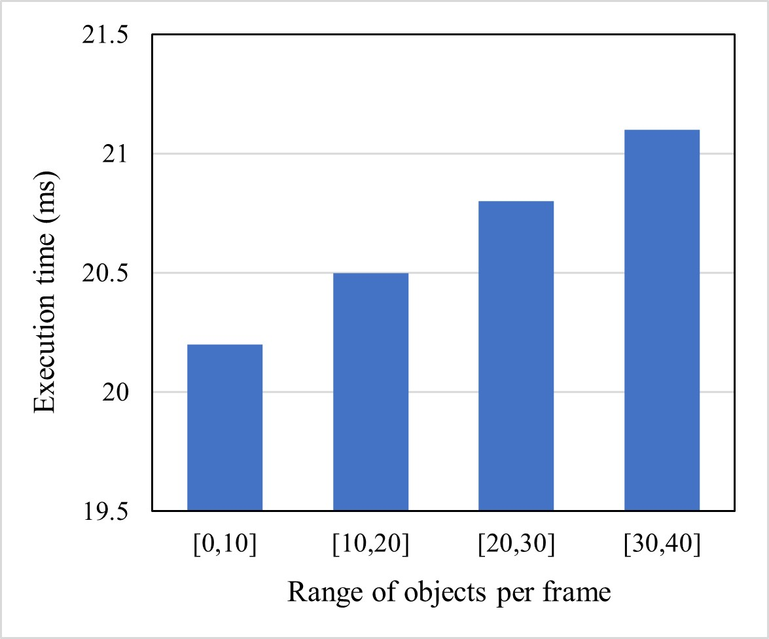
Evaluation
Breakdown latency of Patching framework
Breakdown latency of Patching framework
Patching execution time with the number of objects
0.9
Number of objects increases execution time.
Low gap between number of objects.
Execution time of patching only covers 5% and 8% respectively.
10
Notes:
Number of objects over 50%가 되더라도 execution time 증가 정도가 ~ 밖에 되지 않더라
그리 patching overhead가 크지 않다는 것보이기.

Slide 11

Advisor : Hoon Sung Chwa
Thank you
Dept of Information & Communication Engineering, DGIST
Real-Time Computing Lab
Kang Young Eun (kye0520@dgist.ac.kr)

